Slide 1
The business outcomes
Analyze how much time is spent per ride
Based on date and time factors such as day of week and time of day
Based on which station is the starting and / or ending station
Based on age of the rider at time of the ride
Based on whether the rider is a member or a casual rider
Analyze how much money is spent
Per month, quarter, year
Per member, based on the age of the rider at account start
EXTRA CREDIT - Analyze how much money is spent per member
Based on how many rides the rider averages per month
Based on how many minutes the rider spends on a bike per month

Slide 2
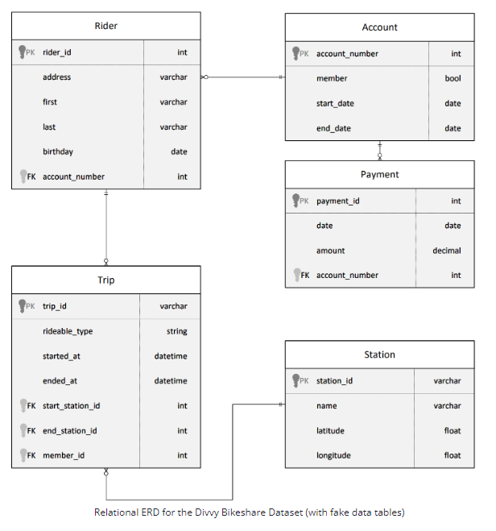

Slide 3
Analyze how much time is spent per ride
Based on date and time factors such as day of week and time of day
Based on which station is the starting and / or ending station
Based on age of the rider at time of the ride
Based on whether the rider is a member or a casual rider
Rider
riderid | bigint
address | nvarchar(4000)
firstname | nvarchar(4000)
lastname | nvarchar(4000)
birthday | nvarchar(4000)
member | bit
startdate | nvarchar(4000)
enddate | nvarchar(4000)
age
Trip
trip_id | nvarchar(4000)
rideable_type | nvarchar(4000)
start_at | nvarchar(4000)
end_at | nvarchar(4000)
start_station_id | nvarchar(4000)
end_stationid | nvarchar(4000)
member_id | bigint
SpentTime
Calendar
Date | Date
Day of week | TINYINT
Year | Year
Month | CHAR(6)
Quarter | CHAR(6)
Aggregate Average and sum for SpentTime base on each item
TimeDay
WeekDay
StartStation
EndStation
AgeYear
Member_flag
Station
stationid | nvarchar(4000)
name | nvarchar(4000)
latitude | float
longlitude | float
TimeSpentPerRide
trip_id
SpentTime
TimeDay(start)
WeekDay(start)
StartStation
EndStation
AgeYears
member_flag

Slide 4
Analyze how much money is spent
Per month, quarter, year
Per member, based on the age of the rider at account start
Rider
riderid | bigint
address | nvarchar(4000)
firstname | nvarchar(4000)
lastname | nvarchar(4000)
birthday | nvarchar(4000)
member | bit
startdate | nvarchar(4000)
enddate | nvarchar(4000)
Calendar
Date | Date
Day of week | TINYINT
Year | Year
Month | CHAR(6)
Quarter | CHAR(6)
Payment
payment_id | nvarchar(4000)
date | nvarchar(4000)
amount | nvarchar(4000)
account_number | nvarchar(4000)
Aggregate Average and sum for amount base on each item
Year
Quarter
Month
accountStartAge
Account_number
MoneySpentPerRide
account_number
amount
quarter
AccountStartAge
month
year

Slide 5
Trip
trip_id | nvarchar(4000)
rideable_type | nvarchar(4000)
start_at | nvarchar(4000)
end_at | nvarchar(4000)
start_station_id | nvarchar(4000)
end_stationid | nvarchar(4000)
member_id | bigint
SpentTime
EXTRA CREDIT - Analyze how much money is spent per member
Based on how many rides the rider averages per month
Based on how many minutes the rider spends on a bike per month
Calendar
Date | Date
Day of week | TINYINT
Year | Year
Month | CHAR(6)
Quarter | CHAR(6)
Payment
payment_id | nvarchar(4000)
date | nvarchar(4000)
amount | nvarchar(4000)
account_number | nvarchar(4000)
member_behavior
member_id
CountTripPerMonth
SpentTimePerMonth
Aggregate Average and sum for total_payment base on each item
CountTripPerMonth
SpentTimePerMonth
SpentPerMember
account_number
total_payment
CountTripPerMonth
SpentTimePerMonth

